Slide 1
Welcome To….
Information and Computer science
Array Operations in Assembly Language
Dr. Sara El-Metwally
Team Members :-
1- Mohamed Adel Mohamed Agwa
2- Mohamed Shaaban Abdullah Zaki
3- Noreen Mohamed Moataz Abd el-Aziz

Slide 2
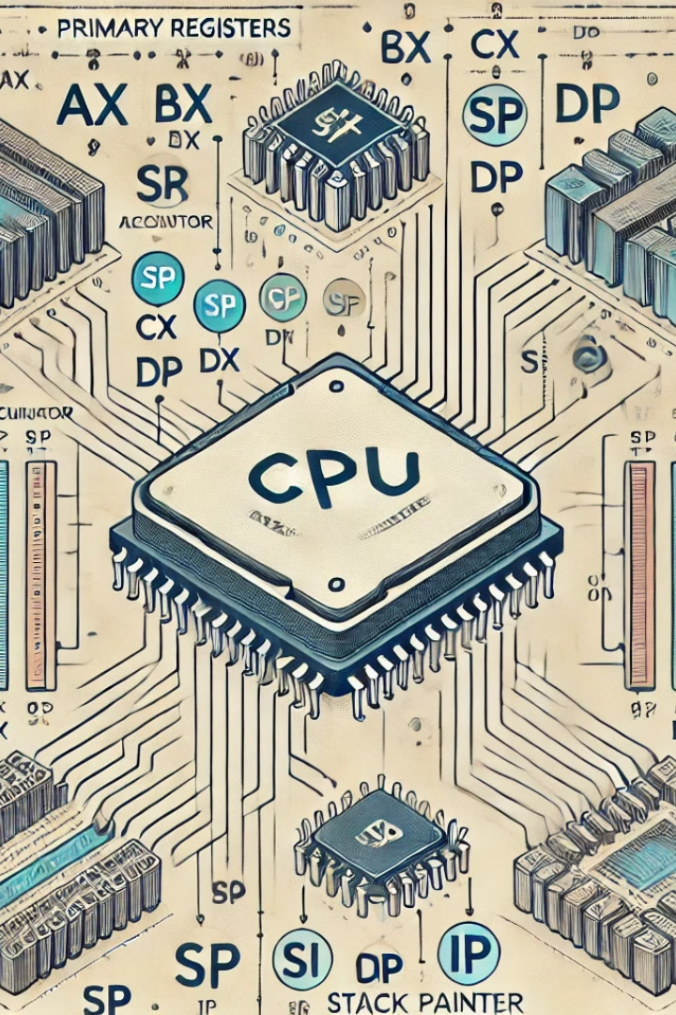
Array Operations in Assembly Language
Let's explore how to manipulate arrays, a fundamental data structure, using assembly language.

Slide 3
Introduction to Arrays
Definition
Key Features
A contiguous block of memory storing elements of the same data type.
Efficient access by index, sequential organization, and dynamic allocation.

Slide 4
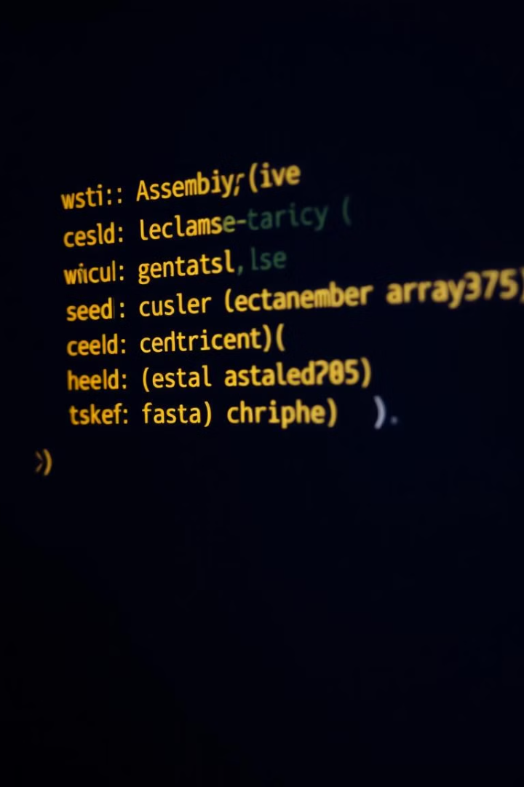
Declaring and Initializing Arrays
1
Declaration
2
Initialization
Specify size and data type using directives.
Assign initial values to elements during declaration.

Slide 5
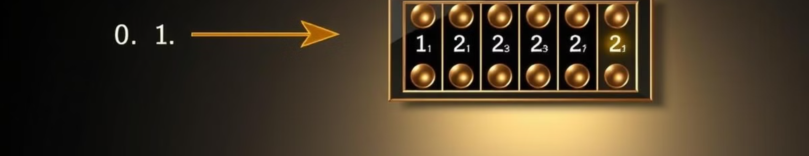
Accessing Array Elements
Index-Based
Pointer Arithmetic
Use the index to calculate the element's memory address.
Move a pointer based on the index to access the element.

Slide 6
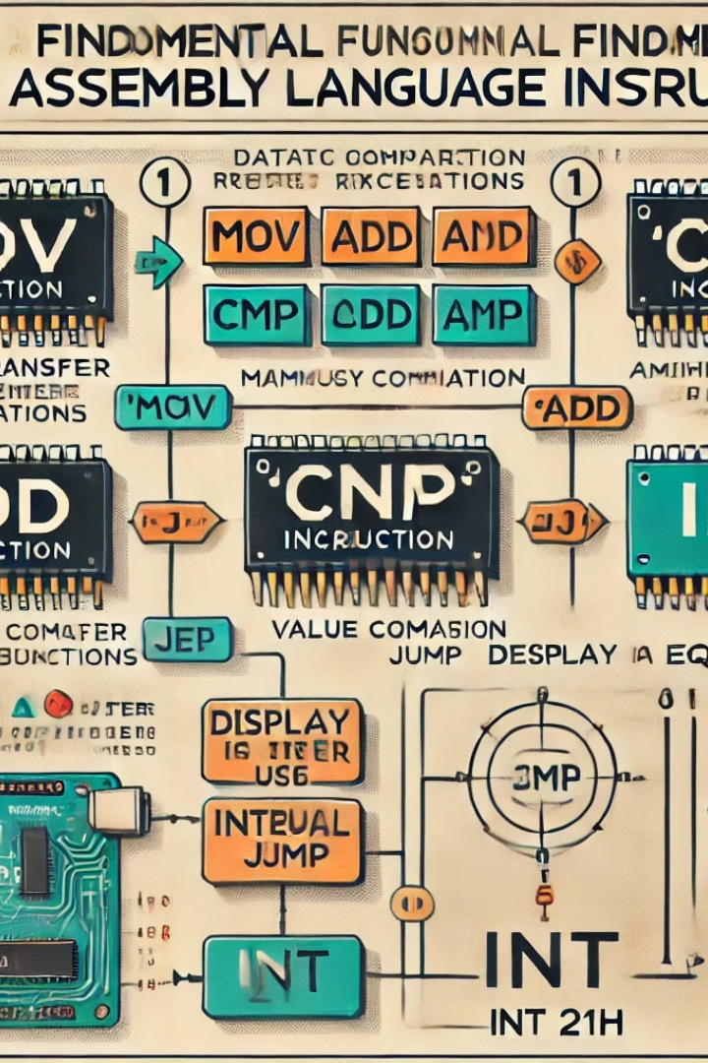


Iterating through Arrays
Looping
Pointer
Iterate over elements using a loop counter.
Increment a pointer to access successive elements.

Slide 7
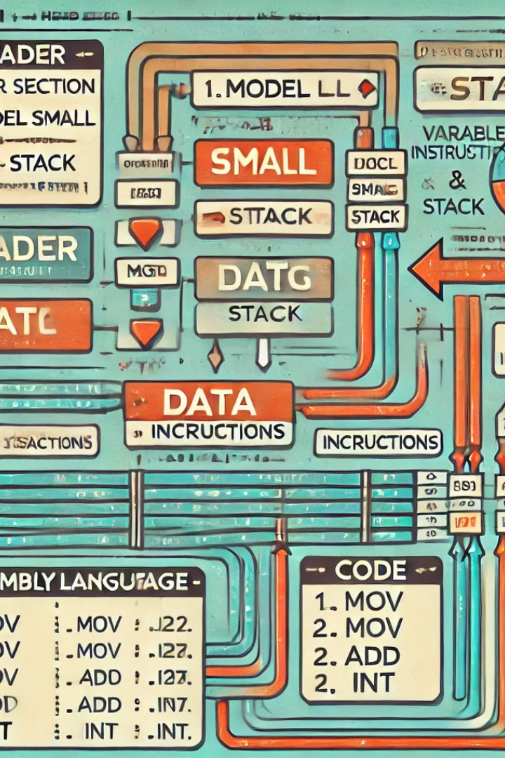
Performing Array Operations
1
Insertion
Add elements to an array.
2
Deletion
Remove elements from an array.
3
Searching
Locate a specific element within an array.

Slide 8



Sorting and Searching Arrays
Sorting
Rearranging elements in a specific order.
Searching
Finding a specific element within a sorted array.

Slide 9



Common Array Algorithms
Bubble Sort
1
Simple, but inefficient for large datasets.
Merge Sort
2
Divide and conquer approach, efficient for large datasets.
Quick Sort
3
Pivot-based, often faster than merge sort.

Slide 10
Conclusion and Best Practices
Understanding
1
Master array operations for efficient data management.
Optimization
2
Choose the right algorithm for your specific needs.
Efficiency
3
Optimize array operations for speed and memory usage.

